Slide 1
Digital Fundamentals
CHAPTER 4 Boolean Algebra and Logic Simplification

Slide 2
Chapter Outline
4–1 Boolean Operations and Expressions
4–2 Laws and Rules of Boolean Algebra
4–3 DeMorgan’s Theorems
4–4 Boolean Analysis of Logic Circuits
4–5 Logic Simplification Using Boolean Algebra
4–6 Standard Forms of Boolean Expressions
4–7 Boolean Expressions and Truth Tables
4–8 The Karnaugh Map
4–9 Karnaugh Map SOP Minimization
4–10 Karnaugh Map POS Minimization
4–11 The Quine-McCluskey Method
4–12 Boolean Expressions with VHDL Applied Logic

Slide 3
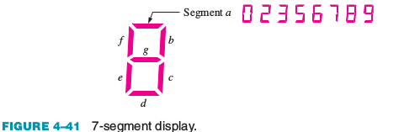
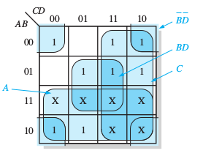
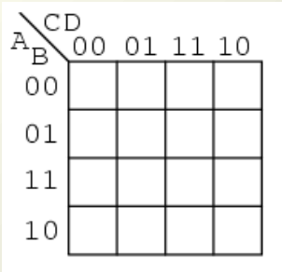
Figure 4–36 Example of the use of “don’t care” conditions to simplify an expression.
In a 7-segment display, each of the seven segments is activated for various digits. For example, segment a is activated for the digits 0, 2, 3, 5, 6, 7, 8, and 9
1
1
1
1
1
1
x
x
x
x
1
1
x
x
Notes:
3

Slide 4
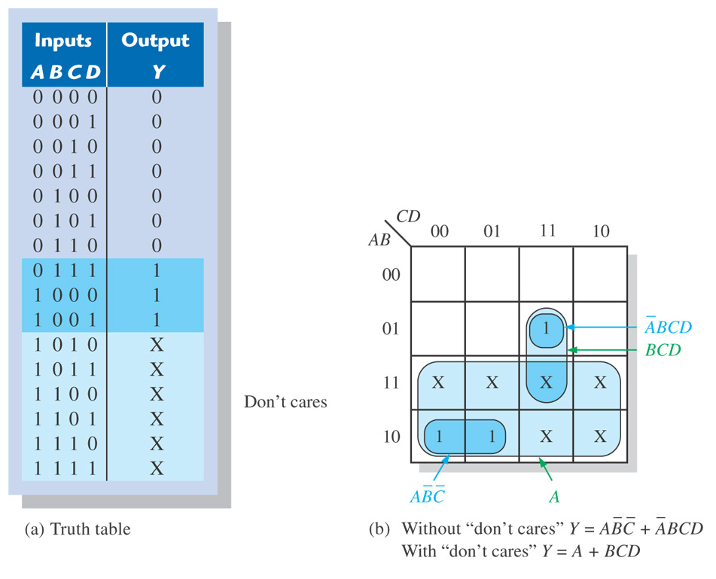
Figure 4–36 Example of the use of “don’t care” conditions to simplify an expression.
∑ m(7,8,9) ∑ d(10, 11,12,13, 14, 15)
Notes:
4

Slide 5
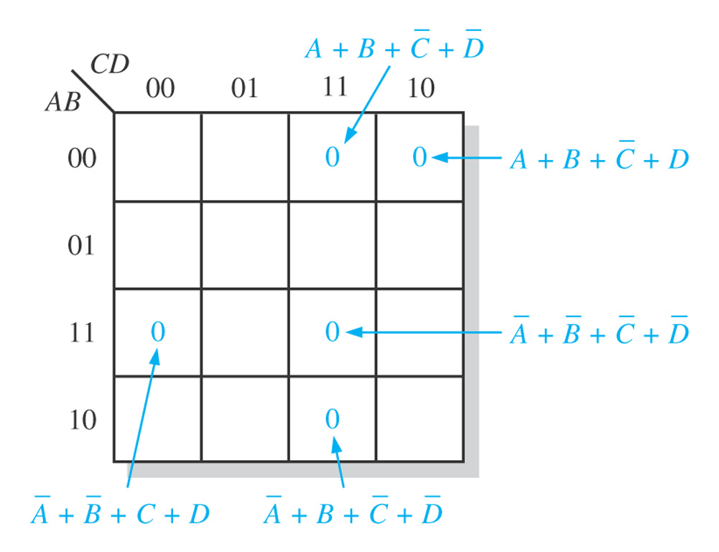
4–10 Karnaugh Map POS Minimization
∏ M (2,3, 11, 12, 15)
Figure 4–38
1100
1011
0010
1111
0011
Notes:
5

Slide 6
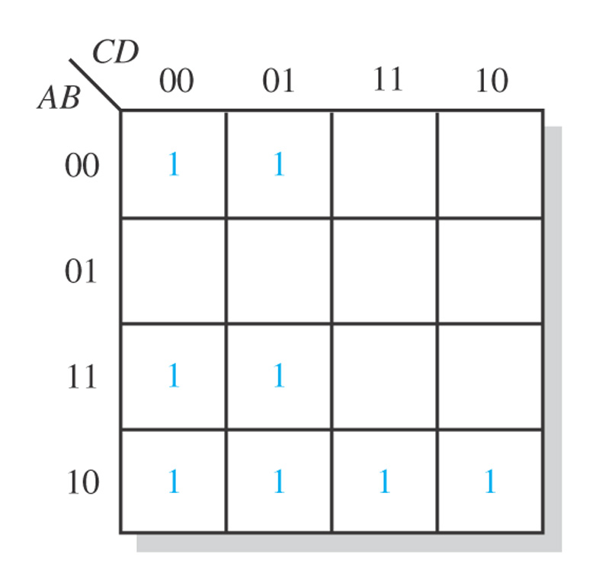
4–10 Karnaugh Map POS Minimization
∏ M (2,3, 11, 12, 15)
Figure 4–38
0000
1000
0010
1001
0100
1100
Notes:
6

Slide 7
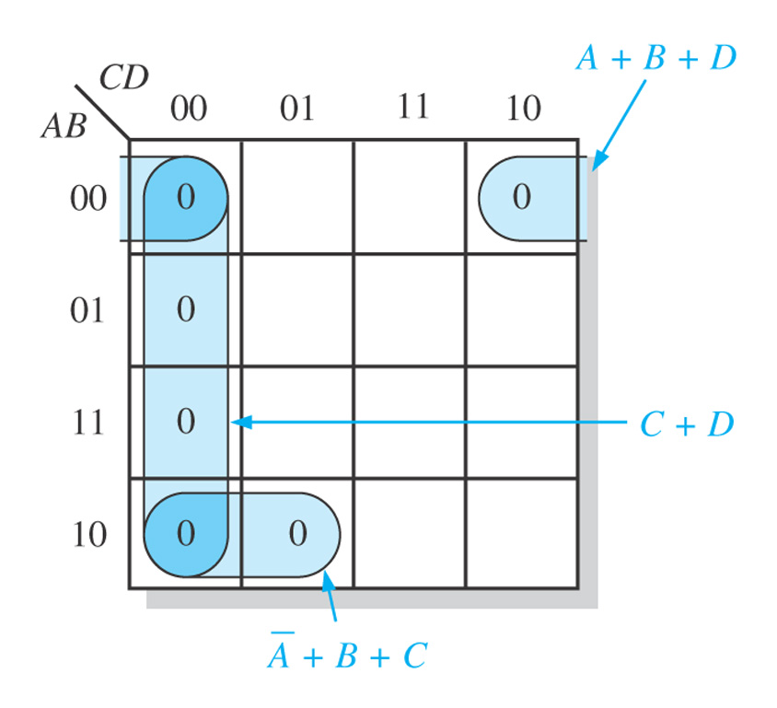
4–10 Karnaugh Map POS Minimization
∏ M (2,3, 11, 12, 15)
Figure 4–38
0000
1000
0010
1001
0100
1100
1
1
3
2
Notes:
7

Slide 8
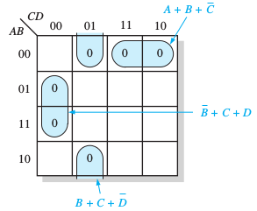
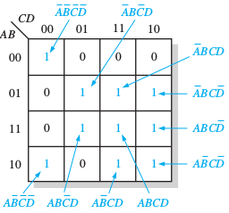

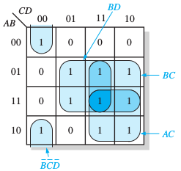
4–10 Karnaugh Map POS Minimization
Figure 4–41
Using a Karnaugh map, convert the following standard POS expression into a minimum POS expression, a standard SOP expression, and a minimum SOP expression.
Notes:
8

Slide 9
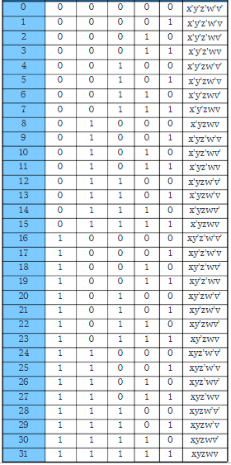
The Karnaugh Map5-Variable Karnaugh Mapping
2⁵= 32 cells
E A B C D

Slide 10
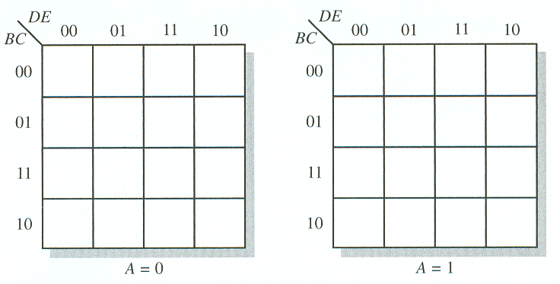
The Karnaugh Map
0
1
3
2
16
17
19
18
4
5
7
6
20
21
23
22
12
13
15
14
28
29
31
30
8
9
11
10
24
25
27
26
5-Variable Karnaugh Mapping

Slide 11
The Karnaugh Map
5-Variable Karnaugh Mapping

Slide 12
The Karnaugh Map
1
1
1
1
1
1
1
1
1
1
1
1
1
1
1
1
1
5-Variable Karnaugh Mapping

Slide 13
The Karnaugh Map
1
1
1
1
1
1
1
1
1
1
1
1
1
1
1
1
1
5-Variable Karnaugh Mapping

Slide 14
The Karnaugh Map
1
1
1
1
1
1
1
1
1
1
1
1
1
1
1
1
1
5-Variable Karnaugh Mapping

Slide 15
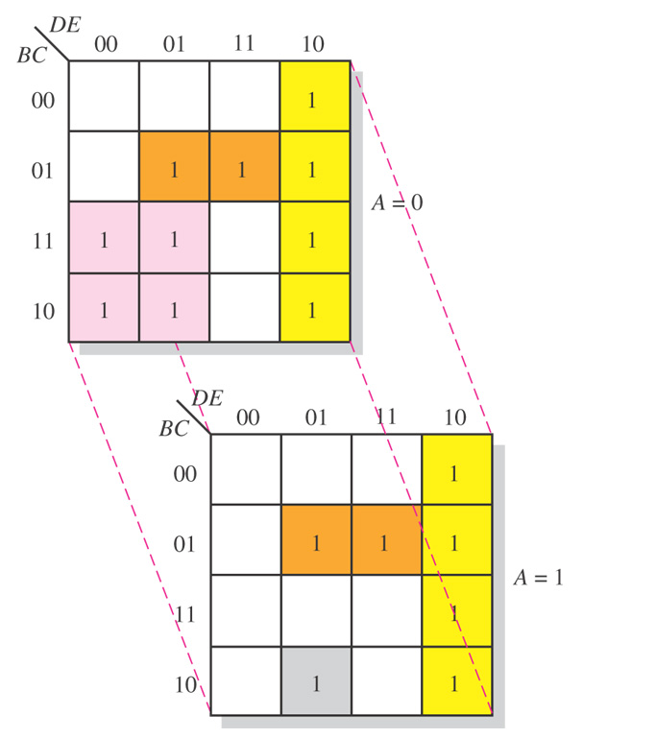
Figure 4–43 Illustration of groupings of 1s in adjacent cells of a 5-variable map.
Notes:
15

Slide 16
The Karnaugh Map
1
1
1
1
1
1
1
1
1
1
1
1
5-Variable Karnaugh Mapping

Slide 17
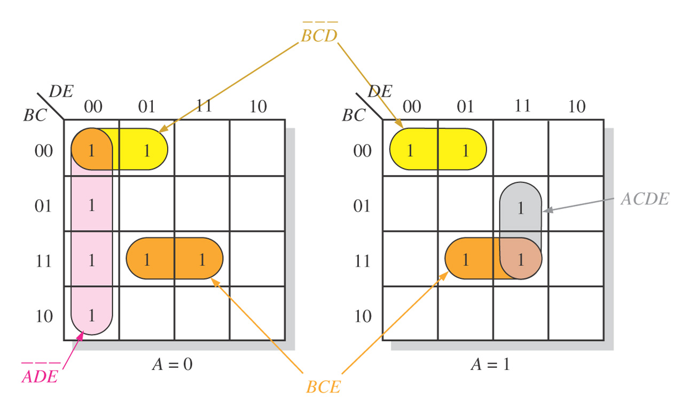
Figure 4–44
0
1
4
8
12
13
15
16
17
23
29
31
Notes:
17

